Slide 1

October 14, 2024
Business Intelligence Report / EDA Report
Aerofit Treadmill Buyer Profile and Data Analysis Report
Author: Rian Qadir
A Comprehensive Analysis of Customer Insights and Recommendations

Slide 2

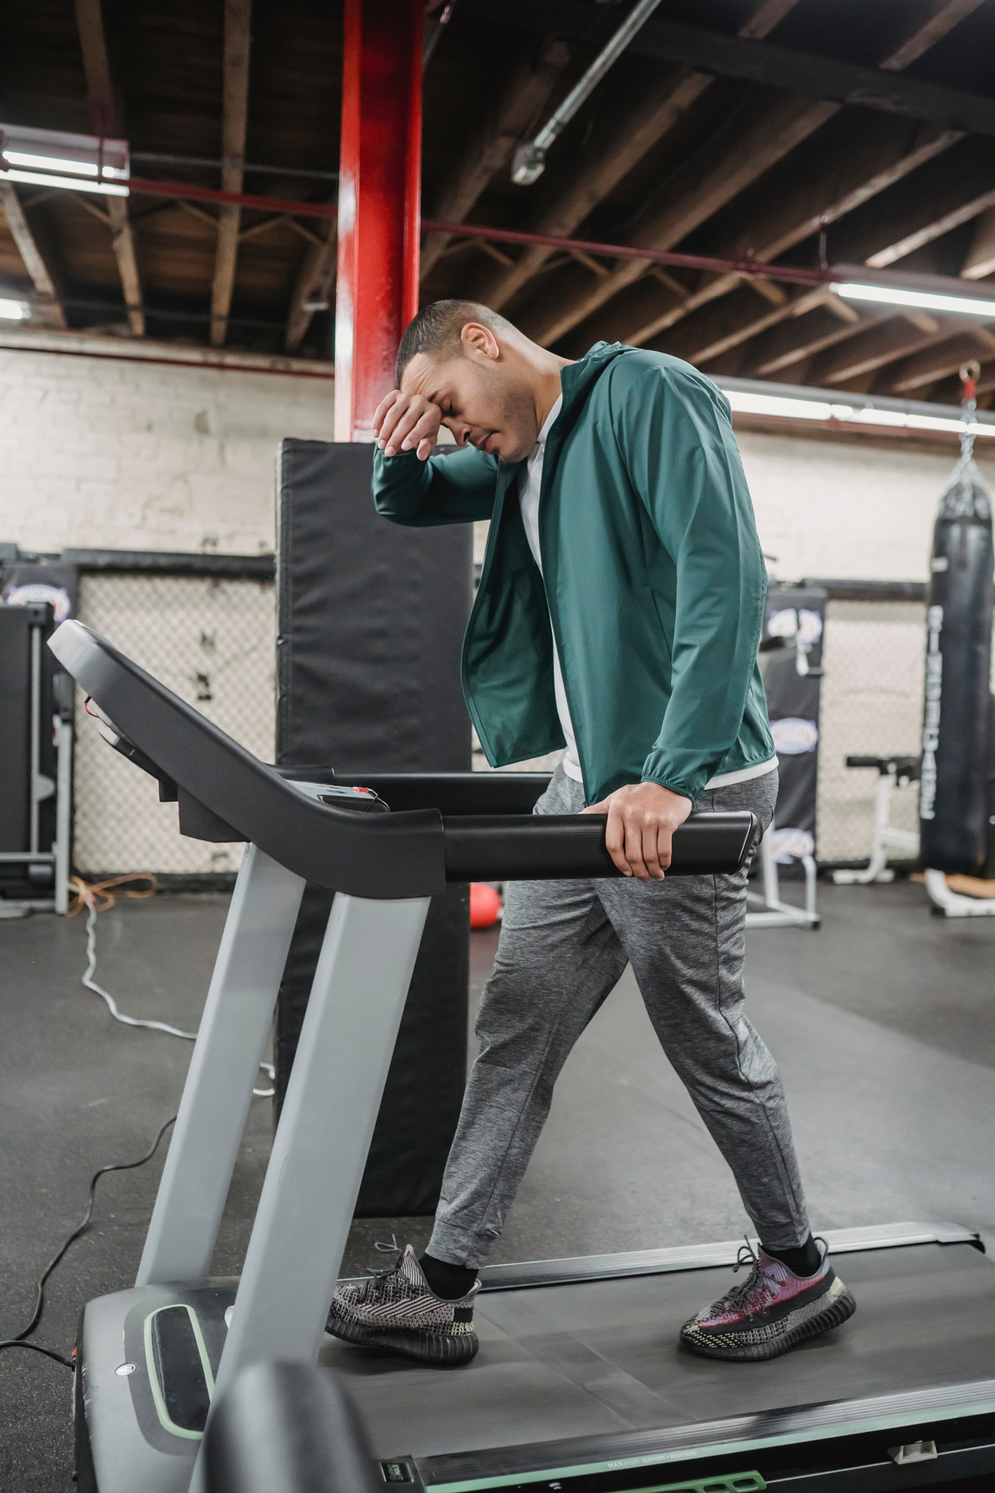


October 14, 2024
Business Intelligence Report / EDA Report
Objective Of the Report
Analyze customer demographics, purchasing behavior, and product performance.
Derive actionable insights to guide marketing strategies and product development.

Slide 3


October 14, 2024
Business Intelligence Report / EDA Report
Project Details
Aim: Identify characteristics of the target audience for Aerofit treadmills.
Product Portfolio:
KP281: Entry-level treadmill ($1,500)
KP481: Mid-level treadmill for runners ($1,750)
KP781: Advanced treadmill with premium features ($2,500)

Slide 4




October 14, 2024
Business Intelligence Report / EDA Report
DATA DESCRIPTION
Dataset: aerofit_treadmill_data.csv
Features:
Product Type (KP281, KP481, KP781)
Age
Gender
Education
Marital Status
Usage (Weekly)
Fitness Level (1-5)
Income (Annual)
Expected Miles (Weekly)

Slide 5


October 14, 2024
Business Intelligence Report / EDA Report
Data Exploration and Processing
Data Import and Overview:
Use of pandas for analysis.
Shape and data types checked; missing values assessed.
Statistical Summary:
Categorical: Gender, marital status, product types.
Numerical: Mean, median, standard deviation for age, income, usage, fitness, miles.

Slide 6

October 14, 2024
Business Intelligence Report / EDA Report
Non-Graphical Analysis
Value Counts: Counts of unique values for categorical features.
Unique Attributes: Listing of unique attributes per category.

Slide 7
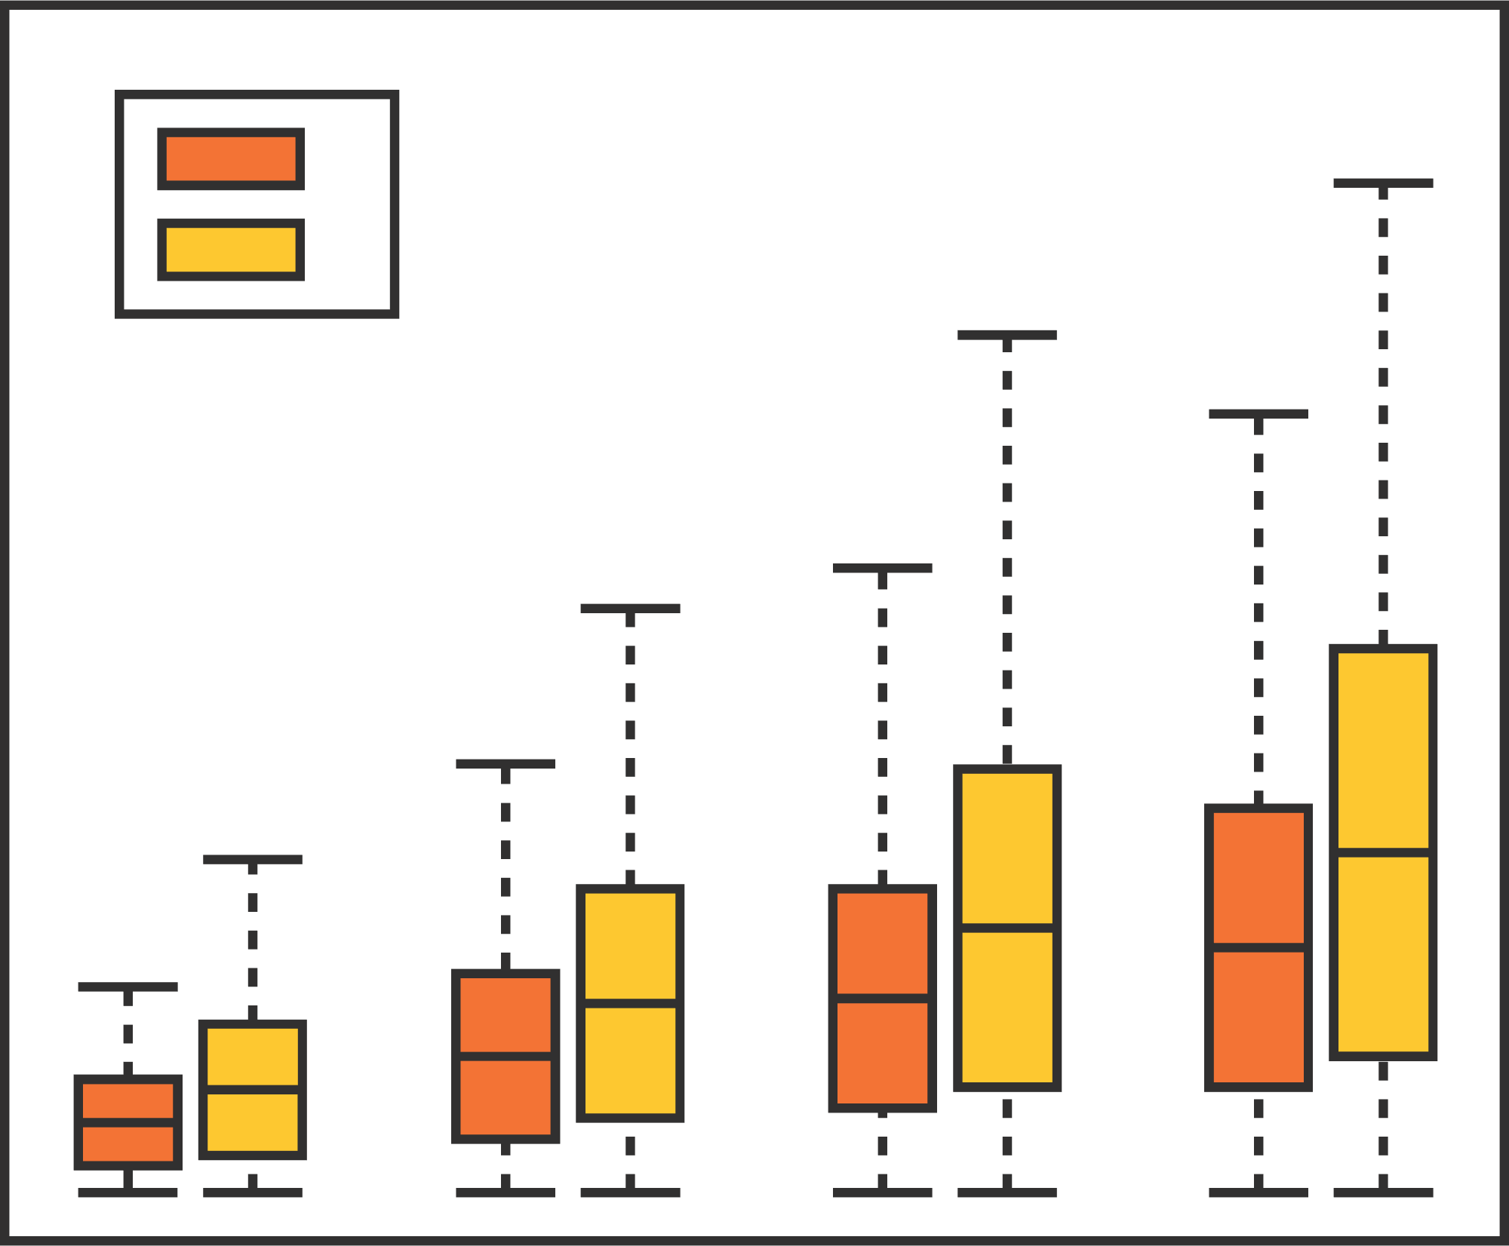
October 14, 2024
Business Intelligence Report / EDA Report
Graphical Analysis - Univariate
Numerical Features:
Distribution Plots: Age, income, usage.
Count Plots: Frequency of fitness levels and product types.
Box Plots: Spread and outliers.

Slide 8

October 14, 2024
Business Intelligence Report / EDA Report
Graphical Analysis -Categorical
Count Plots:
Gender distribution.
Marital status.

Slide 9
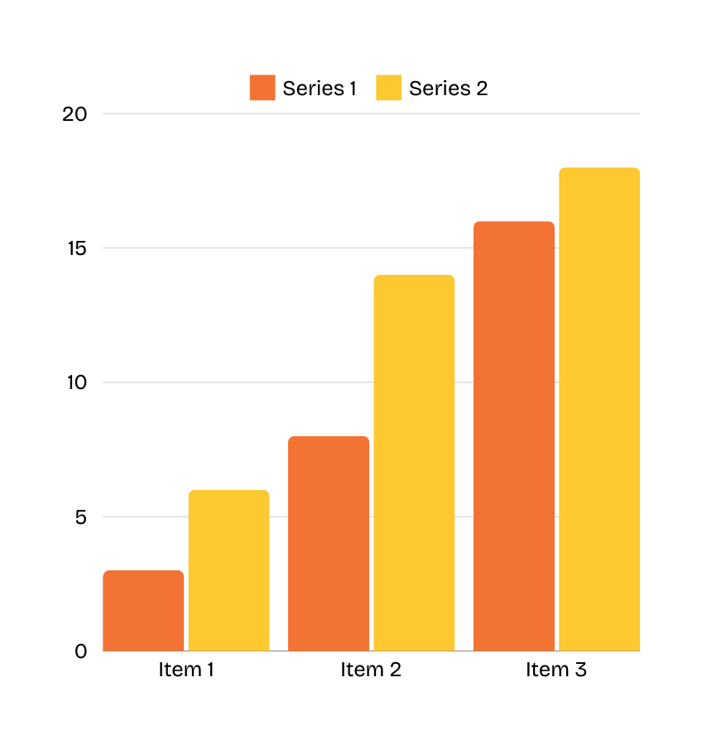


October 14, 2024
Business Intelligence Report / EDA Report
Bivariate Analysis
Product vs. Gender:
Product vs. Marital Status:
Product vs. Age:

Slide 10

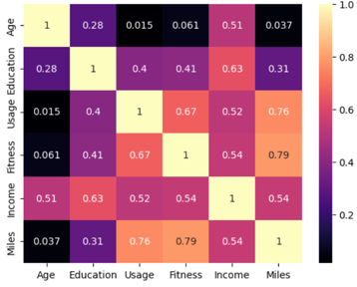
October 14, 2024
Business Intelligence Report / EDA Report
Correlation Analysis
Heatmap:
Strength and direction of relationships among numerical features.

Slide 11
October 14, 2024
Business Intelligence Report / EDA Report
CUSTOMER DEMOGRAPHICS - GENDER DISTRIBUTION
Female Purchases:
KP781: 17.5% of total females.
KP281: 50% female probability.

Slide 12
October 14, 2024
Business Intelligence Report / EDA Report
CUSTOMER DEMOGRAPHICS - AGE DISTRIBUTION
Aged 20s to 30s:
37.22% of customers.

Slide 13
October 14, 2024
Business Intelligence Report / EDA Report
INCOME ANALYSIS
Low-Income Insights:
46.11% of customers (Income ≤ $50,000) purchased a treadmill.

Slide 14
October 14, 2024
Business Intelligence Report / EDA Report
FITNESS LEVEL INSIGHTS
Fitness Level 5:
93.55% purchased KP781.

Slide 15
October 14, 2024
Business Intelligence Report / EDA Report
MARITAL STATUS ANALYSIS
Partnered Customers:
59.44% of total customers.

Slide 16

October 14, 2024
Business Intelligence Report / EDA Report
INSIGHTS AND RECOMMENDATIONS
TARGET AUDIENCE
PRODUCT PORTFOLIO
Focus on male customers, especially partnered.
Promote KP281 and KP481, explore new models.
PRICING STRATEGY
IDENTIFY REGIONS
Assess pricing impacts and implement tiered pricing.
Tailor campaigns to areas with high treadmill demand.

Slide 17
October 14, 2024
Business Intelligence Report / EDA Report
INSIGHTS AND RECOMMENDATIONS
HIGH-INCOME TARGETING
ENHANCE ENGAGEMENT
Health benefits and fitness marketing campaigns.
Loyalty programs and community challenges.
KP781 UPGRADES
CONTINUOUS MONITORING
Integrate new features for fitness enthusiasts.
Adapt strategies based on customer feedback and trends.

Slide 18


October 14, 2024
Business Intelligence Report / EDA Report
Thank you

